Slide 1
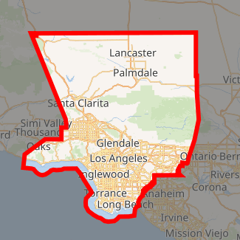
Suggest a neighborhood to open a gas station in Los Angeles
Capstone Project - The Battle of Neighborhoods

Slide 2
Background
Selecting a location to open a business is one of the most important decisions in running a business.
Business decision makers need to consider different factors in finding the right location for the business, such as financial factors, market factors, and the factors that will affect their demand and revenue.
This project can help business owners who are planning to open a gas station in one of the neighborhoods in Los Angeles.

Slide 3
Business Problem
To find the best neighborhood in Los Angeles to open a gas station.
A suitable neighborhood which has fewer compotators with more population.
A gas station is good be in a neighborhood with fewer convenience stores, competitors and more population.
A neighborhood that has fewer competitors is less risky for starting a new business.

Slide 4
Data
Get the data from LA county specific to county fueling satiations to know the number of gas stations with address details. http://geohub.lacity.org/datasets/lacounty::county-fueling-stations
Transform the data into the pandas dataframe.
Extract the Los Angeles neighborhoods data from Wikipedia https://en.wikipedia.org/wiki/Greater_Los_Angeles
Extract Los Angeles population from Wikipedia https://en.wikipedia.org/wiki/Demographics_of_Los_Angeles_County#Housing
Map the neighborhoods using Folium Python library.
Use Foursquare API to get information about some stores around these neighborhoods

Slide 5
Foursquare API
We must look for the convenience stores, some venues and the population Looking for a group of venues in each of the neighborhood:
Looking for the existing gas stations in each of the neighborhoods.
To get an understanding of the competitors in each neighborhood. In total,82 gas stations were found based on LA county data.

Slide 6
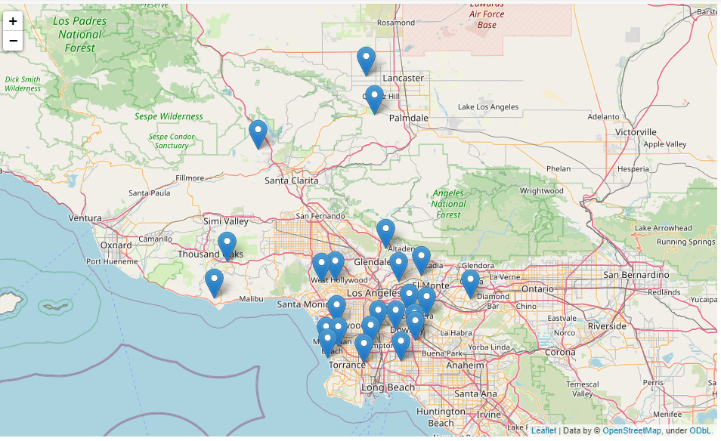
26 neighborhoods of Los Angeles selected for this study

Slide 7
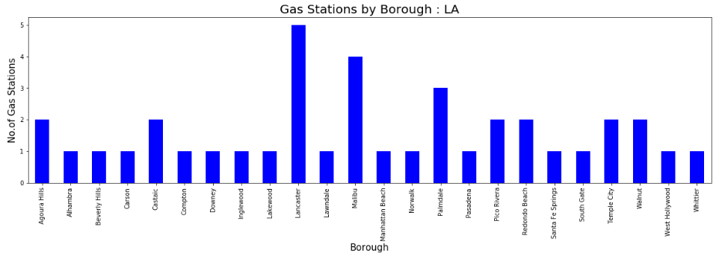
Total gas stations by city in Los Angeles.

Slide 8
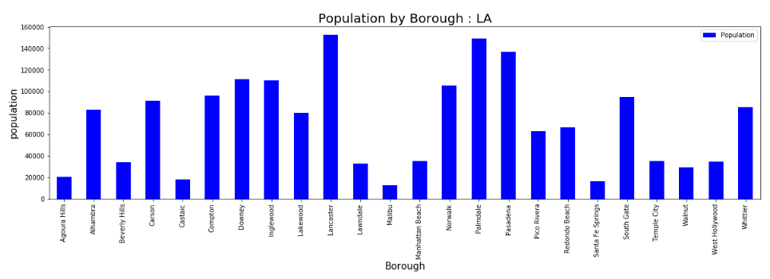
Population by city in Los Angeles.

Slide 9
Methodology
Take the average of the gas stations by population in each city.
Sort the neighborhoods in each city based on their population.
Select the neighborhood with more population that has fewer gas stations and more of other venue categories around.

Slide 10
Results and Discussion
Pasadena, Downey and Inglewood are the best locations based on the population and existing gas stations.
It has the greatest number of population and is expected to attract many people to visit.
The final decision is dependent on the budget of the client to rent the place. According to the budget limitations of the client, we can find other neighborhoods and select the one with the greatest number of venues and a smaller number of gas stations around.

Slide 11
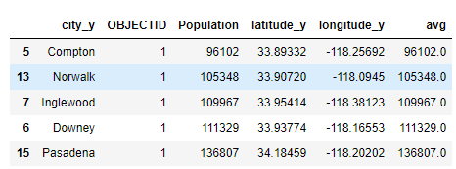
Below are top five locations where business users can consider to open a gas stations in Los Angeles.

Slide 12
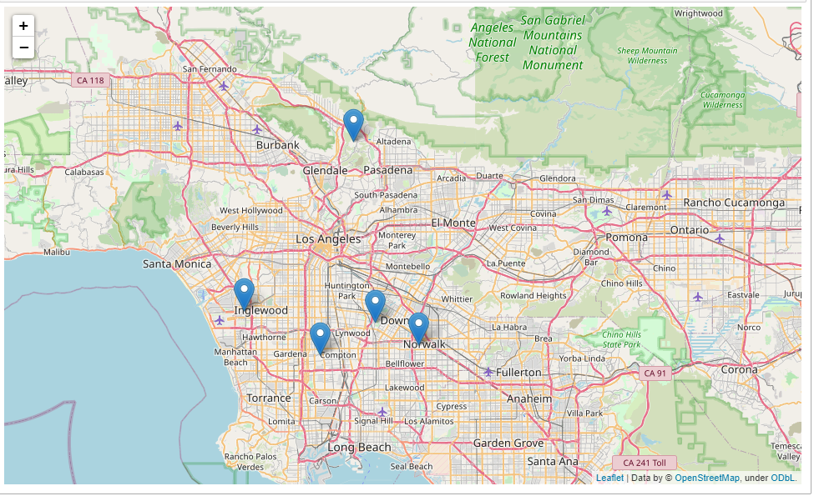

Slide 13
Limitations and Future Extensions
In this study I used the data from Los Angeles city from 2005and the population data from 2010.
We only considered population of the neighborhoods, but we can consider other factors like distance to freeways and big employers near by.
we considered the population and gas stations count from different years.
As an extension one can consider:
specific locations such as particular streets
use different weights for different venues

